Slide 1
Jakirul Islam
ID. 193002101
Department: CSE

Slide 2
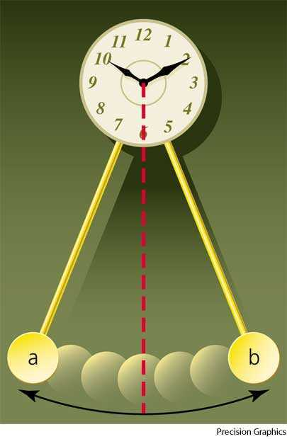
Oscillation
A periodic back and forth motion when the body moves half of its time period in one direction and the other half of its time period in the opposite direction, is called oscillation.
Motion of simple pendulum, vibration of tuning fork, motion of a spring etc. are examples of oscillation.

Slide 3
Different Types of Oscillation
Damped Oscillation
Free Oscillation
Maintained Oscillation
Forced Oscillation

Slide 4
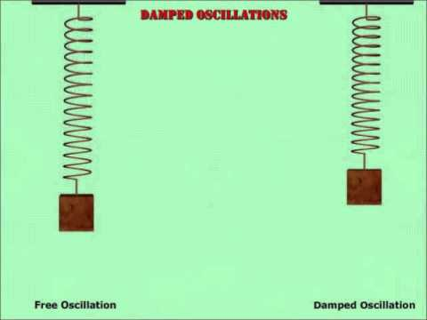
Free Oscillation
When a body vibrates with its own natural frequency then it is said to executing free oscillations.
Examples:
a) Vibrations of tuning fork.
c) Oscillations of simple pendulum.

Slide 5
Thank you.

